Slide 1





SKIZA-AI
KENYAN
SWAHILI
SPEECH EMOTION RECOGNITION SYSTEM

Slide 2



TEAM
01
IAN KORIR
02
HELLEN SAMUEL
03
GREGORY MIKURO
04
DOREEN WANJIRU
05
ESTHER FRANCIS

Slide 3


OVERVIEW
01
02
03
04
Background
Problem Statement
Objectives
Data Understanding
05
06
07
08
Data Preparation
Modeling
Evaluation & Deployment
Conclusions
Skiza-AI

Slide 4

BACKGROUND
Approximately 70% of customer interactions are handled via phone.
Nearly 60% of customers feel that their emotions are often misunderstood.
Global call center market is projected to reach $496 billion by 2027, with Africa experiencing significant growth.
Despite this, up to 85% of call centers still rely on manual processes for emotion detection that is prone to errors
Speech Emotion Recognition (SER) is a technology that analyzes vocal tone and patterns to detect and interpret emotions in real-time.
Skiza-AI

Slide 5

PROBLEM STATEMENT
The absence of a robust, Swahili-specific Speech Emotion Recognition (SER) model hinders the ability of customer service call centers in Kenya to accurately detect and respond to customer emotions. This limitation can lead to suboptimal customer interactions and reduced satisfaction levels. Therefore, this project aims to develop an emotion recognition model tailored to the linguistic and cultural nuances of Kenyan Swahili, enabling more effective and empathetic customer service interactions in call centers.
Skiza-AI

Slide 6



OBJECTIVES
Skiza-AI
Extract acoustic features from Kenyan Swahili speech samples, exploring the relationship between these features and emotional expression.
01
Develop a feature selection methodology customized for Kenyan Swahili and apply data augmentation techniques to enhance dataset diversity and robustness.
02
Create and deploy a classification model with a target accuracy of at least 80% for emotion recognition in Kenyan Swahili speech.
03

Slide 7





RESEARCH METHODS
Data collection
Tools and Format
Procedure
Data Cleaning
Aimed to engage at least 200 volunteers
Aimed to collect at least 1000 samples (anger, sad, surprised, calm, happy)
Employed personalized interview approach
In person and online calls
Social media and real-time personal connections (volunteers)
Smartphone audio recorders
Audio (allowed all formats preferred wav)
Explained our research
Obtained verbal consent,
Recorded the data
Ascertained no PII collected
Labeled the data
Normalized the audio volumes
Removed the noise
Skiza-AI

Slide 8
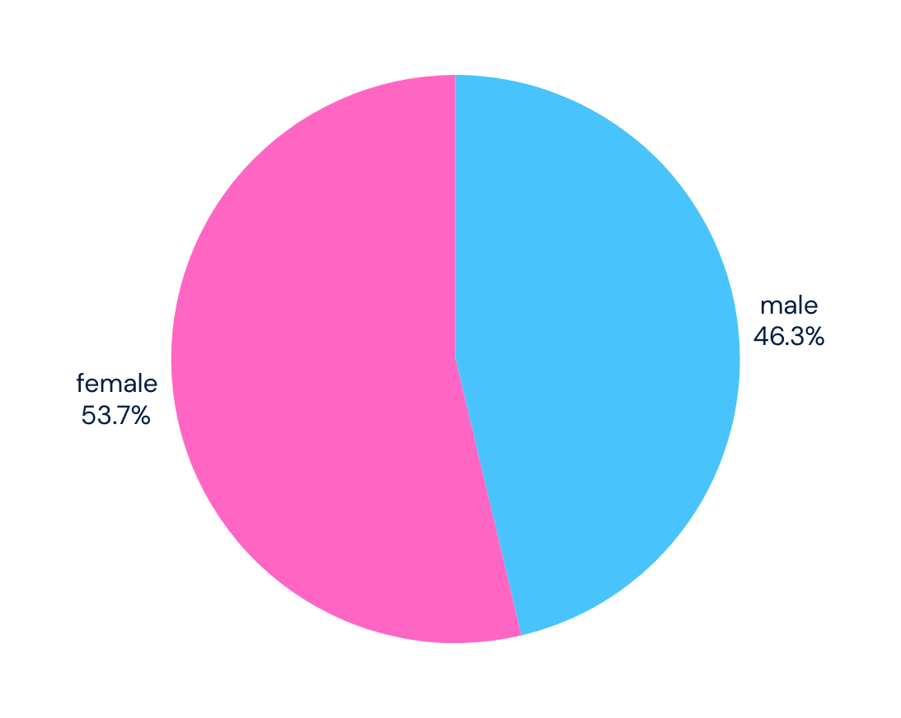
Data Analysis
Skiza-AI
242 participants (112 males) contributed 1,856 recordings, with 1,180 used and the rest under review; with emotions evenly distributed across the selected audio files.
88%
of the data was
collected using
online channels

Slide 9




MODELING
FEATURES EXTRACTED:
MFCC_1 to MFCC_13
(Mel-Frequency Cepstral Coefficients)
Chroma_1 to Chroma_12
Spectral Contrast
Spectral Bandwidth
Zero Crossing Rate
RMS (Root Mean Square Energy)
Spectral Centroid
Spectral Roll-off
MODELS TRAINED:
KNN, Random Forest, XGBoost, CatBoost, SVM, MLP

Slide 10

EVALUATION
KNN
Random Forest
XGBoost
Catboost
Accuracy58%
Accuracy 61%
Accuracy
83%
Accuracy70%
Skiza-AI

Slide 11


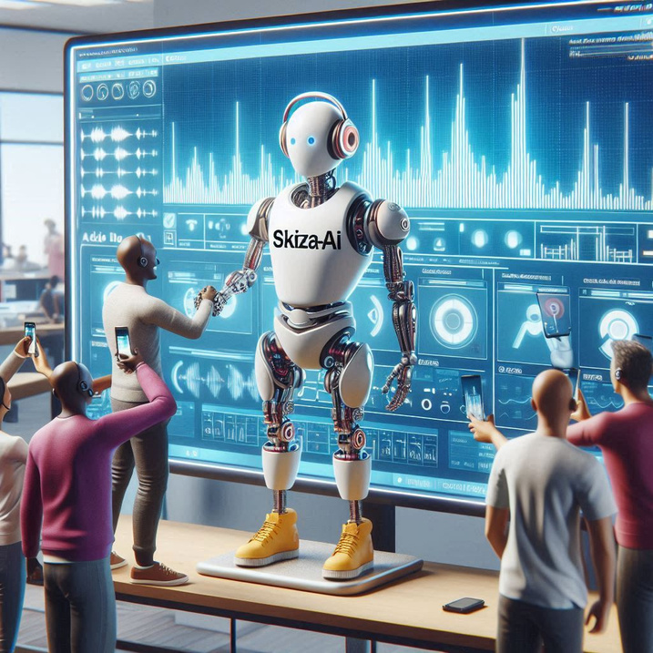

Acoustic Feature Analysis
CONCLUSION
Acoustic features such as Mel-Frequency Cepstral Coefficients (MFCCs) captured essential emotional cues.
Feature Selection and Data Augmentation
Standardizing audio length and generating synthetic variations improved the model's ability to recognize emotions.
Model Development and Deployment
CatBoost was selected for its superior handling of categorical features with an accuracy of 83%. Was deployed using Streamlit.
Skiza-AI

Slide 12

01
Skiza-AI
Resource allocation
Recommendations and Next Steps
02
NLP integration
03
Scale-Up (multilingual and volume-wise)
04
Continuous monitoring and evaluation

Slide 13
QUESTIONS?
Skiza-AI

